Slide 1
MANUFACTURING TECHNOLOGY-I [ME6302]
III SEMESTER / II YEAR – ‘A’ SECTION
MECHANICAL ENGINEERING
[Academic Year: 2015-2016 – Batch: 2014-2018]

Slide 2
‘Manufacturing’ is derived from the Latin,
manus = hand and factus = made,
that is, the literal meaning is “made by hand”.
‘Manufacturing’ means the making of goods and articles by hand and/or by machinery.
‘Manufacturing Technology’ or “Production Technology” can be defined as the study of the various processes required to produce parts and to assemble them into machines and mechanisms.

Slide 3
CLASSIFICATION OF MANUFACTURING PROCESSES
(Metal) Casting Processes
Joining Processes
(Metal) Forming Processes
Sheet metal Processes
Plastic materials (Polymers) processes
Machining processes
Powder Metallurgy
Heat treatment & Surface treatment processes
Assembly processes

Slide 4
U-I METAL CASTING PROCESSES

Slide 5
SAND CASTING
Sand moulds
Type of patterns
– Pattern materials
– Pattern allowances
Moulding sand
– Types
– Properties
– Testing
Core making
– Types
– Applications
Moulding machines
– Types
– Application
MELTING FURNACES
– Blast
– Cupola
SPECIAL CASTING PROCESSES
– Shell
– investment casting
– Ceramic mould
– Lost Wax process
– Pressure die casting
– Centrifugal casting
– CO2 process
– Stir Casting
(Working principle)
DEFECTS IN SAND CASTING

Slide 6
INTRODUCTION
Ferrous metals
Iron
Non-Ferrous metals
Aluminium
Some of the complicated shapes may not be produced on the components with conventional machining processes.

Slide 7
(SAND) CASTING
Casting is one of the processes used for making components of complicated shapes in larger quantity.
Producing metal parts by pouring molten metal into the mould or mold cavity of the required shape and allowing the metal to solidify.
The solidified metal piece is called as “casting”
A plant where the castings are made is called a “Foundry”

Slide 9
SAND MOULDS
Mould is the cavity of the required shape made in moulding sand or other material.
Pattern is the model of required casting made in wood, metal or plastics.
Foundry processes
Pattern making
Mould making
Casting

Slide 10
Pattern
Primarily used to produce the mould cavity in sand.
It is slightly larger than the desired casting, due to various allowances.

Slide 11
TYPES OF PATTERN
Solid or Single piece pattern
Split pattern
Loose piece pattern
Match plate pattern
Sweep pattern
Skeleton pattern
Segmental pattern
Shell pattern

Slide 12
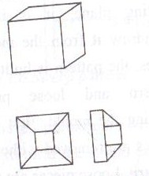
SOLID or SINGLE PIECE Pattern

Slide 13
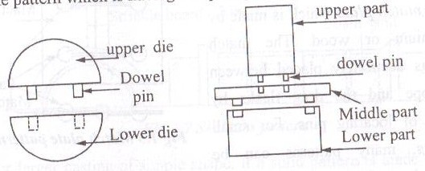
SPLIT Pattern

Slide 14
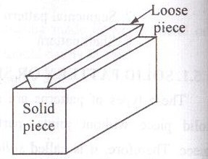
LOOSE PIECE Pattern

Slide 15
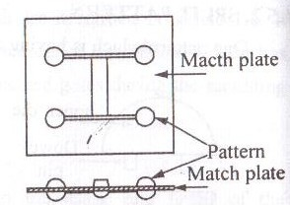
MATCH PLATE Pattern

Slide 16
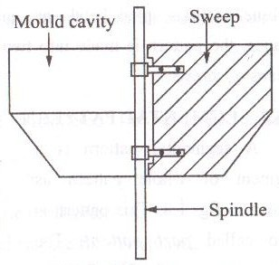
SWEEP Pattern

Slide 17
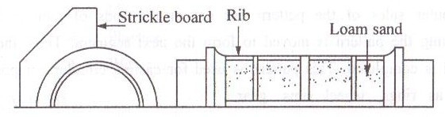
SKELETON Pattern

Slide 18
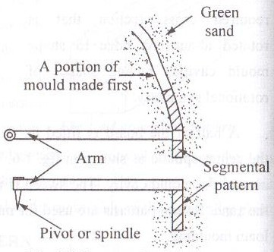
SEGMENTAL Pattern

Slide 19
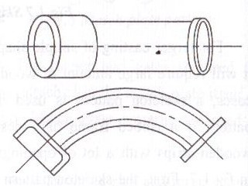
SHELL Pattern

Slide 20
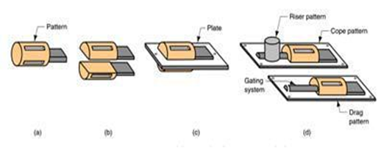
(a) solid pattern
(b) split pattern
(c) match-plate pattern
(d) cope and drag pattern

Slide 21
PATTERN MATERIALS
Wood – Teak, Mahogany, White pine….
Metal – Cast Iron, Brass, Aluminium, White metal……
Plaster
Plastics
Wax

Slide 22
COLOUR SCHEME FOR PATTERNS
Surface as cast : BLACK
Machined surface : RED
Core prints an seats : YELLOW
Loose pieces : YELLOW / RED (diagonal stripes)
Stop-off : YELLOW / BLACK
(diagonal stripes)

Slide 23
SELECTION OF PATTERN MATERIALS (Requirements of a good pattern)
Secure the desired shape and size of the casting.
Cheap and readily repairable.
Simple in design for ease of manufacture.
Light in mass and convenient to handle.
Have high strength and long life in order to make as many moulds as required.
Retain its dimensions and rigidity during the definite service life.

Slide 24
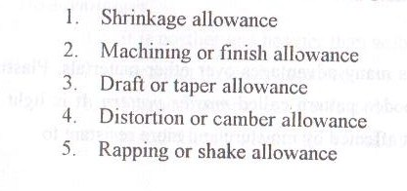
PATTERN ALLOWANCE
The difference in the dimensions of the casting and the pattern is due to the various allowances considered while designing a pattern for a casting.
The various types of allowances are,

Slide 25
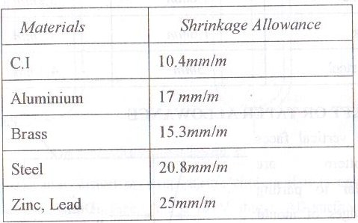
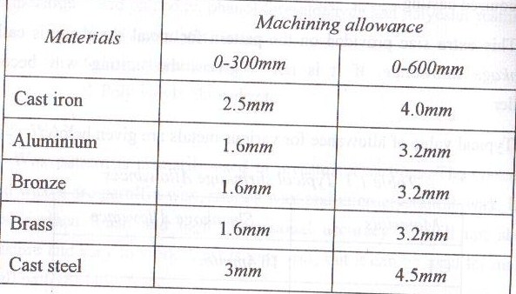
SHRINKAGE ALLOWANCE
MACHINING or FINISH ALLOWANCE

Slide 26
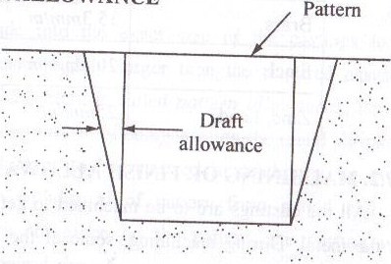
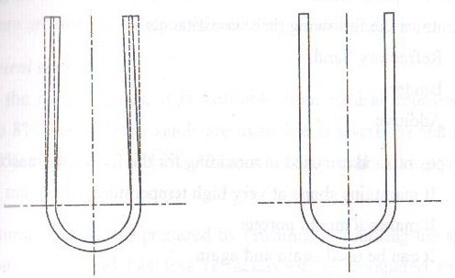
DRAFT or TAPER ALLOWANCE
DISTORTION or CAMBER ALLOWANCE

Slide 27
RAPPING or SHAKE ALLOWANCE
To remove the pattern out of mould cavity, it is slightly rapped or shaked to detach it from the mould cavity.
Negative Allowance – subtracted from pattern dimensions.

Slide 28
MOULDING SAND
Special type of sand is used for making mould.
3 Essential constituents
Refractory sand
Binder
Additive
Silica is widely used as moulding sand.
It has 80 to 90 % - Silica Dioxide
It gives refractoriness to the sand.

Slide 29
TYPES OF SAND
Natural Sand
➔ Available from natural deposits
➔ Needs only 5-8% water
➔ Used for light castings in Ferrous & Non-Ferrous
2. Synthetic Sand
➔ Prepared (with desired properties, as we like) artificially by
mixing clay free sand
➔ Used in mechanized production machine moulding & High
pressure moulding.
3. Special Sand
Zircon sand
Chromite sand

Slide 30
TYPES OF MOULDING SAND
GREEN SAND
- in moist state
- 5 to 8 % of water & 16 to 30 % of clay
- Having good damping capacity
- Small and medium size castings
DRY SAND
- in dry stage
- called as ‘dry sand mould’ or ‘skin dry mould’
- large castings

Slide 31
3. Facing Sand
4. Loam Sand
Consists of fine silica sand, fine refractories, clay (arround 50 %), graphite, fibre and water.
Melting large castings – Bell, Roller, Pulleys etc.,
5. Backing Sand
Used to backup the facing sand and to fill the whole volume of the mould box.
Old sand may used repeatedly
6. Parting Sand

Slide 32
PROPERTIES OF MOULDING SAND
Porosity or Permeability
Plasticity or Flowability
Strength or Cohesiveness
Refractoriness
Adhesiveness
Collapsibility

Slide 33
MOULDING SAND
According to the amount of clayey matter they contain, the moulding sands are classified as:
Silica Sand : Upto 2% clay
Lean or Weak sand : 2 to 10% clay
Moderately strong sand : 10 to 20% clay
Strong sand : Upto 30% clay
Extra strong sand : Upto 50% clay
Types of sand :
1. Natural 2. Synthetic 3. Chemically coated

Slide 34
Desirable Mold sand Properties and Characteristics
Strength - to maintain shape and resist erosion
Permeability - to allow hot air and gases to pass through voids in sand
Thermal stability - to resist cracking on contact with molten metal
Collapsibility - ability to give way and allow casting to shrink without cracking the casting
Reusability - can sand from broken mold be reused to make other molds.

Slide 35
BINDERS
Organic - Cereal, resins, pitch, drying oil, molasses etc.,
In-Organic - Fire clay, KAOLINITE, BENTONITE and ILLITE
High Thermo Chemical stability
TYPICAL GREEN MOULDING SAND for gray iron
Silica sand = 68 to 86%
Clay = 10 to 20%
Water = 3 to 6%
Additives = 1 to 6%

Slide 36
ADDITIVES
Additives are added to the molding sand to improve the properties like strength, refractoriness and permeability.
Necessary of Additives:
To give a good surface finish to the casting
To eliminate casting defects
(Expansion of moulding sand or Contraction of he casting)

Slide 37
Sea Coal – fine bituminous coal powder
Saw dust
Pitch – distilled from soft coal
Cereals – ground corn flour or corn starch
Silica flour – very fine powdered silica
Special additives
Fuel oil
Dextrin
Molasses
Iron oxide

Slide 38
MOULDING SAND PREPARATION
Mixing of sand
Tempering of sand
Conditioning of sand

Slide 39
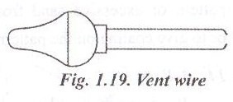
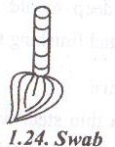
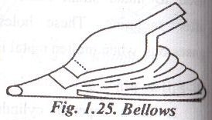
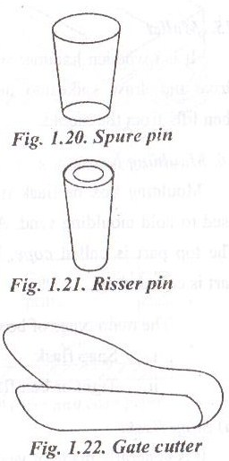
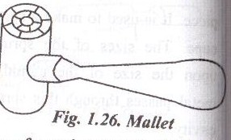
MOULDING TOOLS

Slide 40
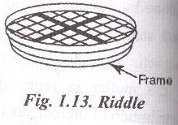
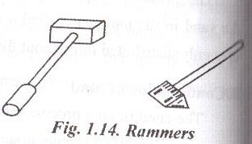
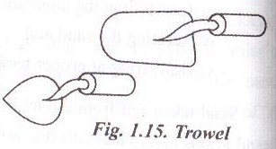
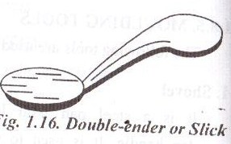
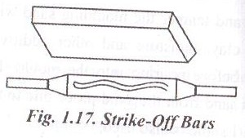
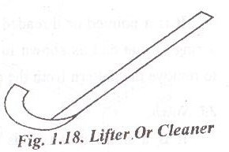

Slide 41
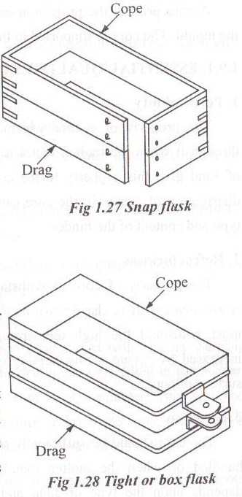
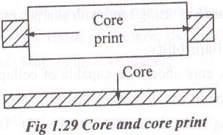

Slide 42
CORE
A Core is a body made of sand which is used to make a cavity or a hole in a casting.
Core Print is the projection on a pattern.
It forms a seat in the mould.
Core is supported in the seat formed by the Core Print.

Slide 43
TYPES OF CORE
According to the state of core
Green sand core
Dry sand core
According to the position of the core in the mould
Horizontal core
Vertical core
Balanced core
Hanging core
Drop core

Slide 44
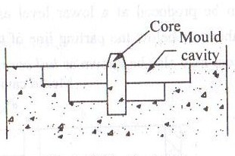
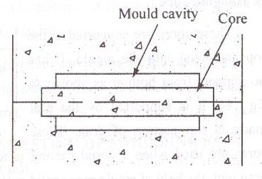
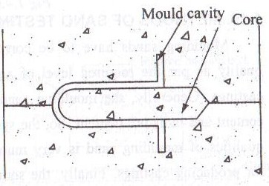
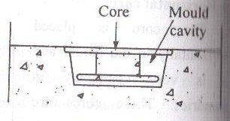
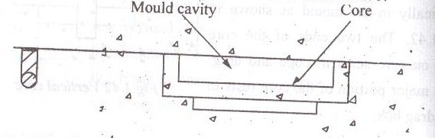

Slide 45
ESSENTIAL QUALITIES OF A CORE:
Permeability
Refractoriness
Strength
Collapsibility
Stability
MATERIALS:
Core Sand (Refractories) – Silica sand, Zircon, Olivin etc.,
Binders – Vegetable or Mineral oil, Corn flour, Resins water, Fire clay, Bentonite, Urea
Additives – Wood flour, Coal powder, Seal coal, Graphite, Cow dung, Straw etc.,

Slide 46
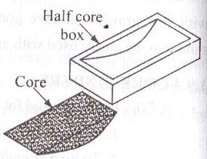
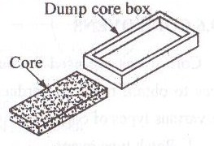
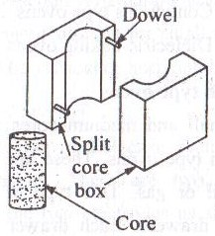
CORE BOXES
Half core box
2. Dump or slap core box
3. Split core box

Slide 47
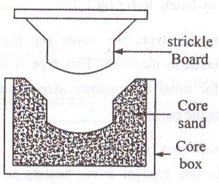
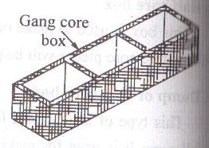
4. Strickle core box
5. Gang core box

Slide 48
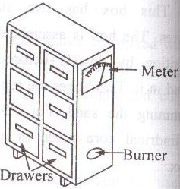
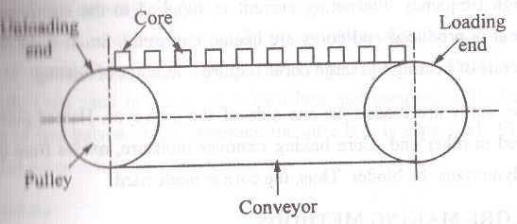
CORE OVENS
Batch type ovens
2. Continuous type ovens

Slide 49
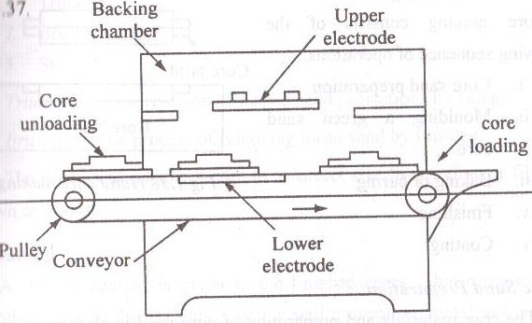
3. Dielectric baking ovens

Slide 50
CORE MAKING METHOD
Hand core making
Core sand preparation
Moulding a green sand core
Baking - 200ºC to 350ºC
Finishing
Trimming – removing fins and sand projections by filing
Brushing – process of removing loose sand by brushes
Sizing – making a core to a correct size by grinding or filing
Coating
Coating material – powdered graphite or Silica or Mica
Coating is applied either by dipping or spraying. This is also called as Dressing

Slide 51
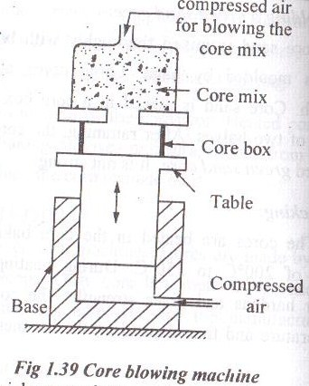
2. Hot core box method

Slide 52
Baking or Curing will be lengthens the production process and lowers the operating efficiency of the foundry.
This can be eliminated by using quickset synthetic resins-bonded core sands.
Binders – Phenol formaldehyde, Urea formaldehyde, Phenolic alcohols and Furan-base binders.
These binders are capable of hardening at 230-250ºC in a short time (2 to 3 minutes)
Catalysts – Benzene sulfonic and Nitric acids (to speed up the process of curing)

Slide 53
3. Synthetic resin-based cold curing Method
These sands do not require heat treatment after obtaining
from ovens.
In this method core is allowed to stand in the air for
30 to 120 min. (having strength of about 800 to 1200 kPa.
Strength is lesser than HOT BOX METHOD.
Only used for moderately complex and simple configuration.

